Slide 1
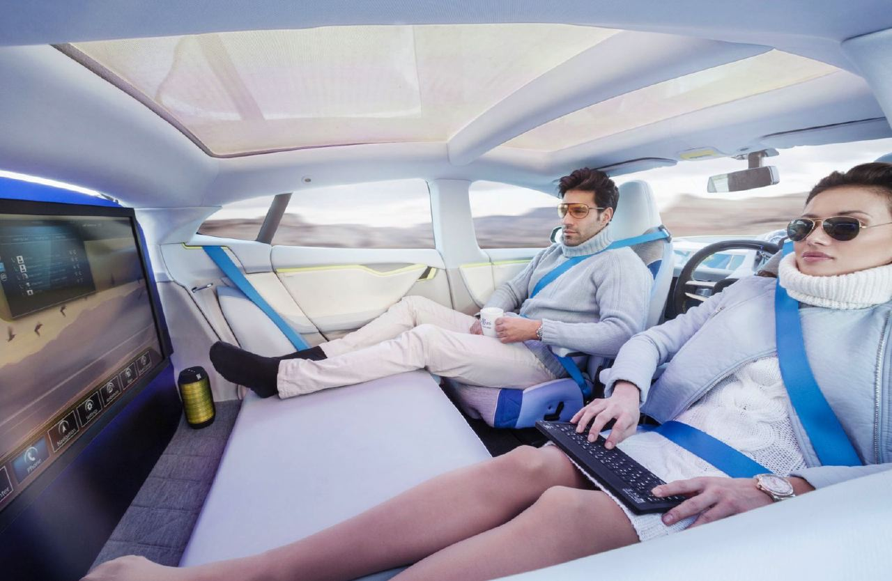
Cars of the Future:
Computers with Wheels
by Victor Haydin, Head of Products & Services

Slide 2
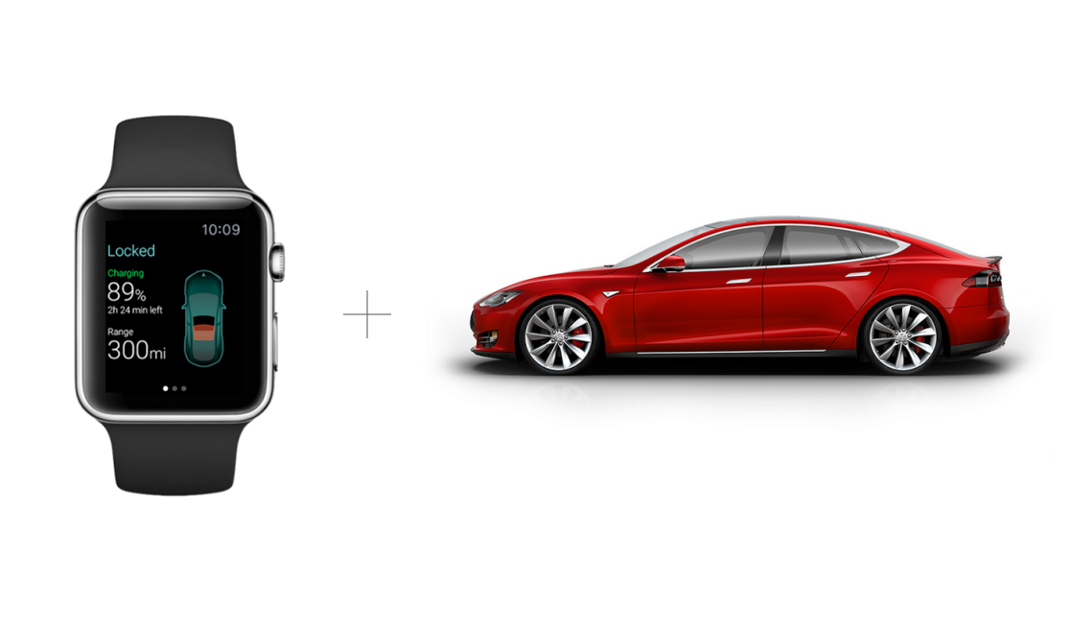

Slide 3
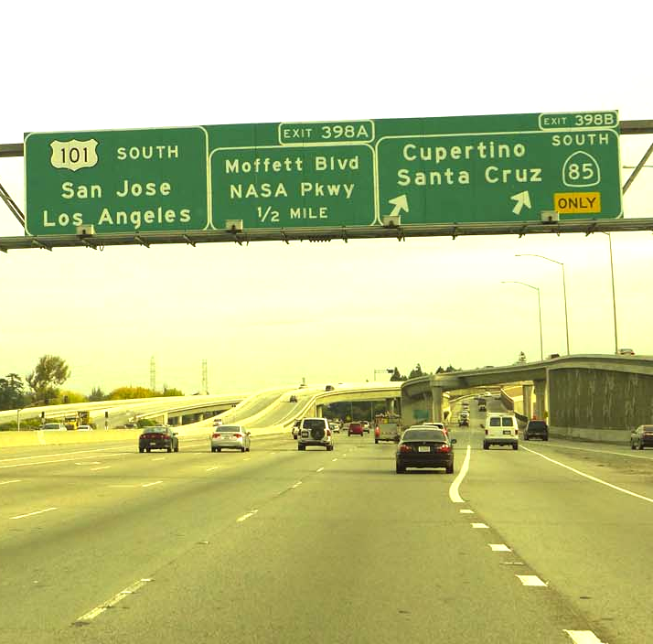
Agenda
Why cars mater?
...for app developers?
...and why now?
How is it going to be?

Slide 4
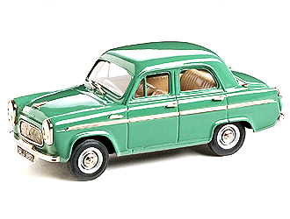


Slide 5
Average american person spends 101 minute per day driving.
That’s approximately 7% of their life.
11.8% of US GDP is generated by automotive industry.

Slide 6
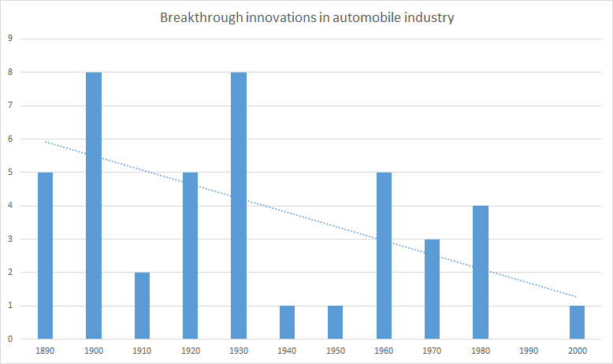

Slide 7



Since 2010
Tesla is the first US car maker that went public since Ford in 1953.
Self-driving car is the most funded project of Google X.
Uber is the most valuable startup in the world

Slide 8

Smells like money

Slide 9
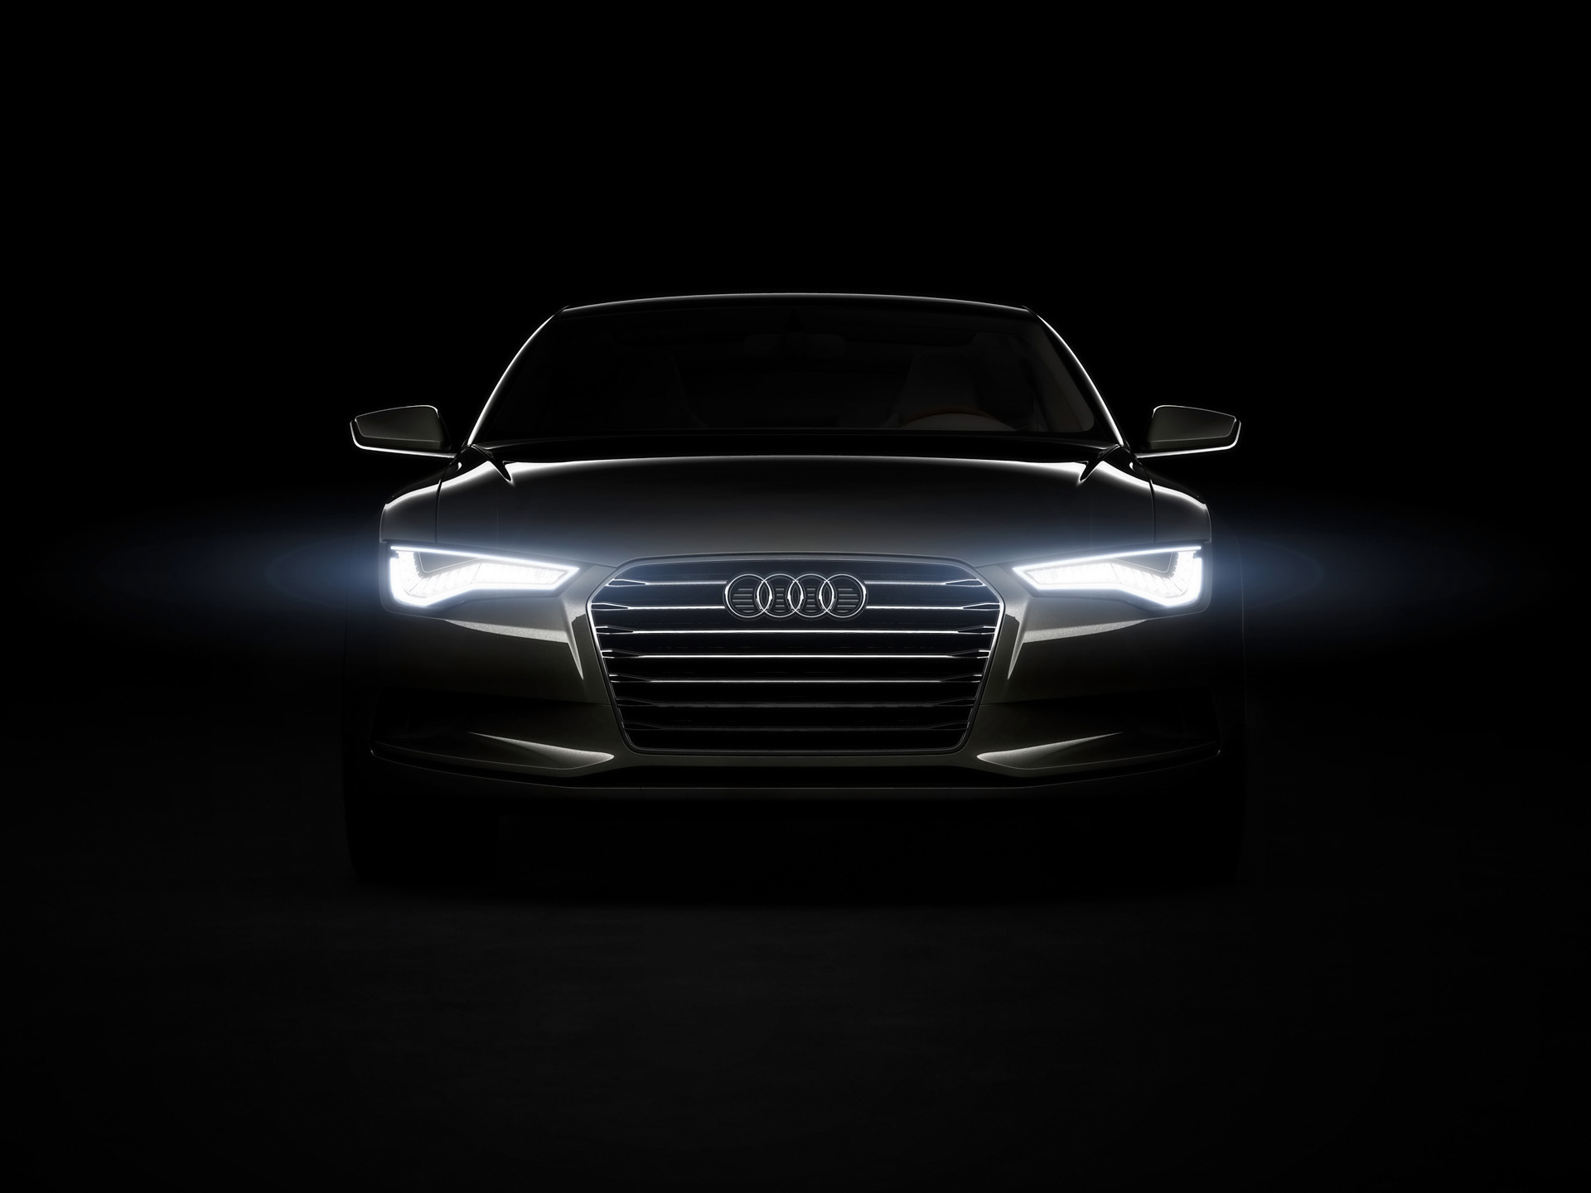
Opportunities
Smartphone
Infotainment systems
Connected cars
V2E, V2I, V2V
Self-driving cars

Slide 10
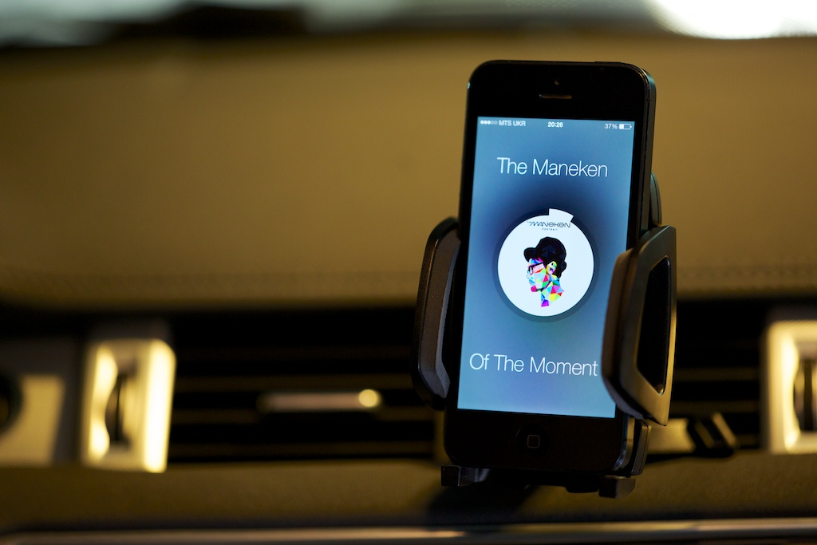
Smartphone
Notes:
That’s obvious: all we use smartphones in cars.
UX is the key thing here. If it makes sense to use an app in car - someone will do it. Think about their UX.
Poor integration with the car can lead to bad UX.
It gets better, though.

Slide 11
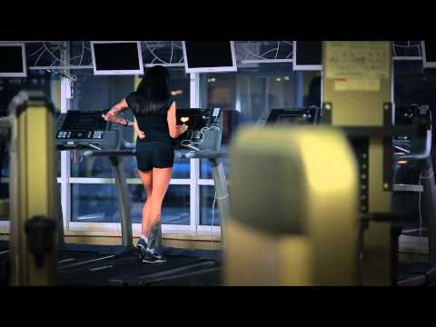

Slide 12
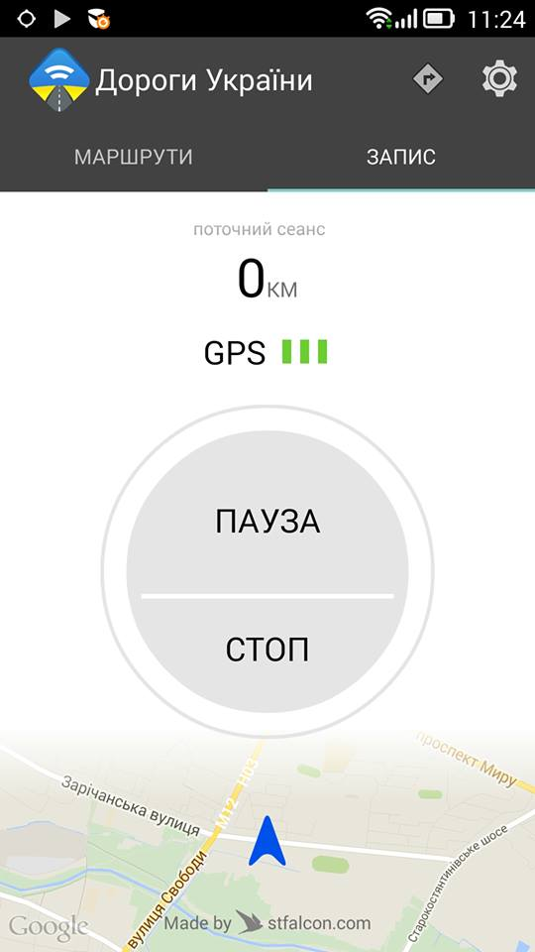

UARoads.com

Slide 13
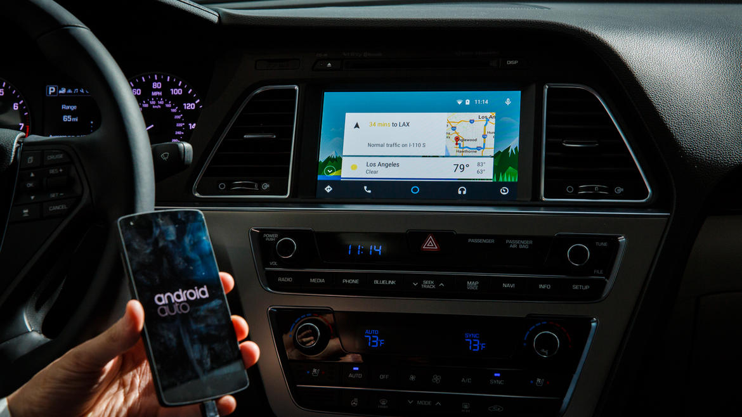
Notes:
Android auto, apple’s carplay etc.
Smartphone battery could be an issue. Addtionally, car have much more resources on-board, so limit its performance with phone’s hardware is bit stupid.

Slide 14
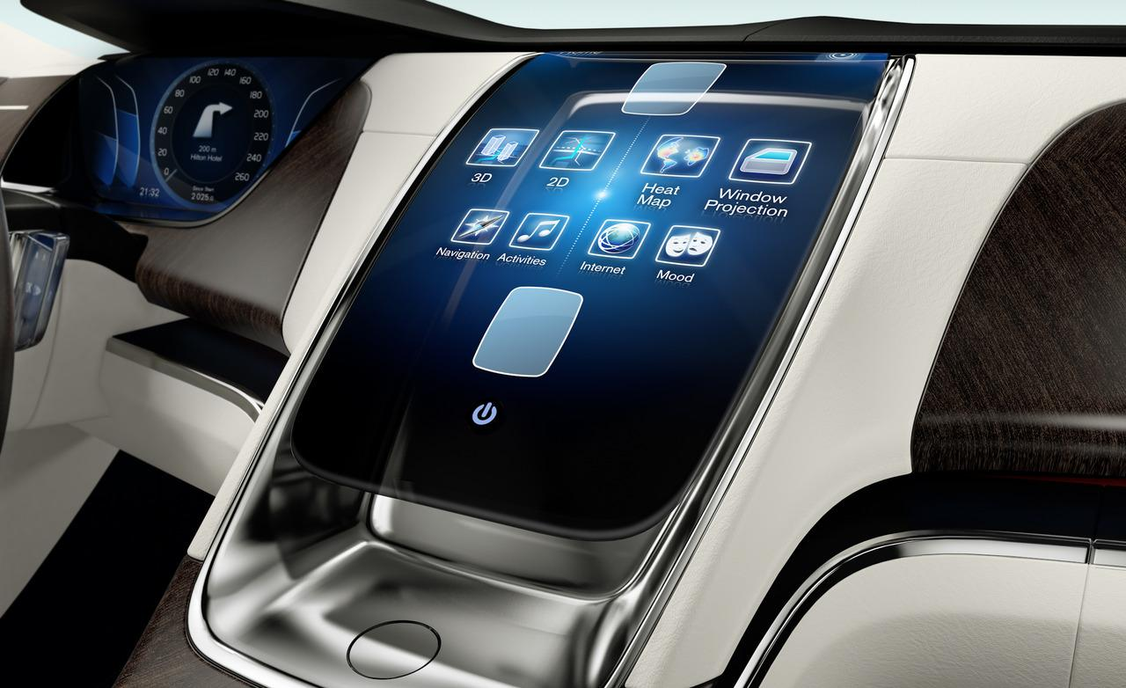
Infotainment
Notes:
Normally they suck. Especially when compare them with smartphones.
Some have kind of apps, but OS could be exotic and distribution is pain in the ass.

Slide 15
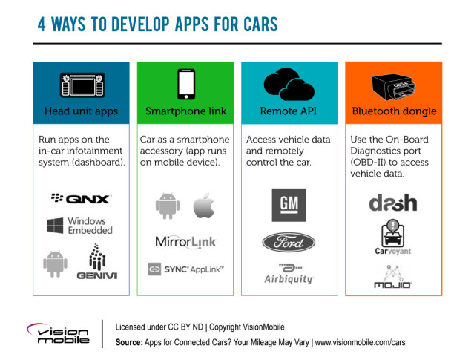

Slide 16
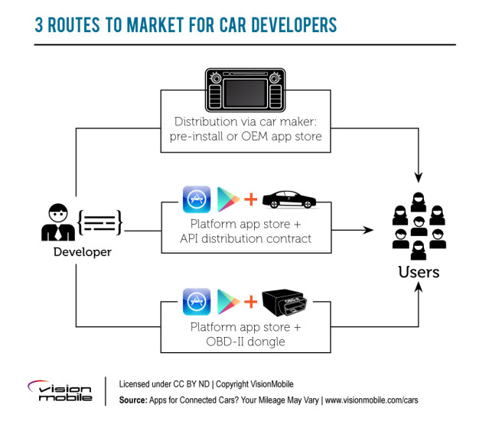

Slide 17
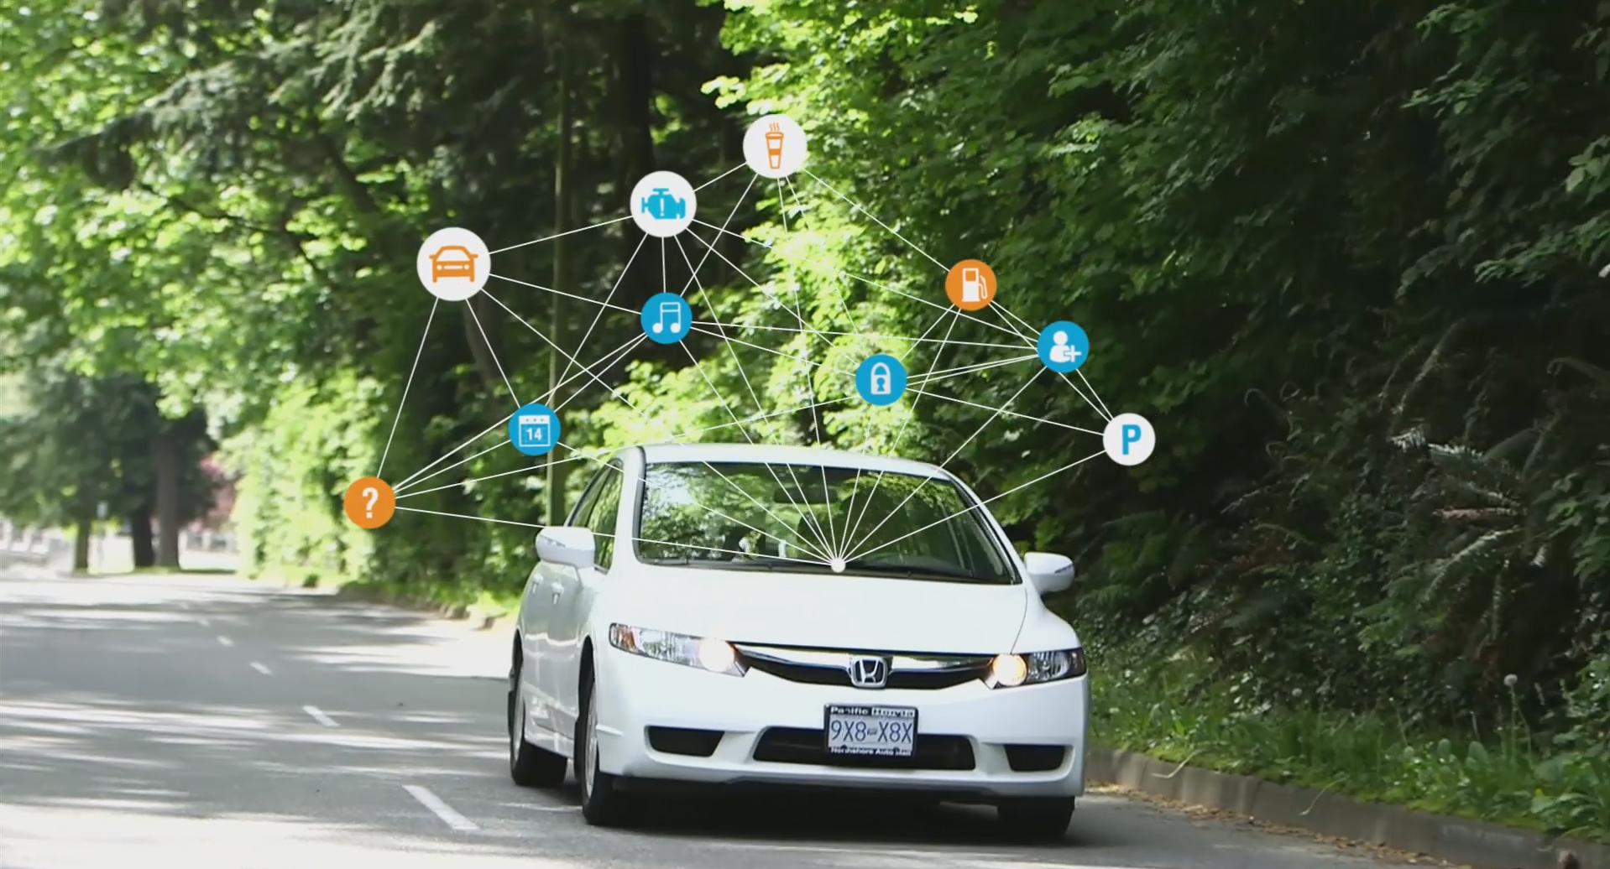
Connected car
Notes:
Maintenance, insurance, service, security and other areas that benefit from connectivity.
UPS case: cars turning right only (?)
Other way, control your car via API.

Slide 18
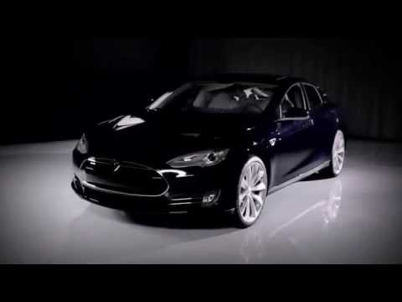
Notes:
Maintenance, insurance, service, security and other areas that benefit from connectivity.
UPS case: cars turning right only (?)
Other way, control your car via API.

Slide 19
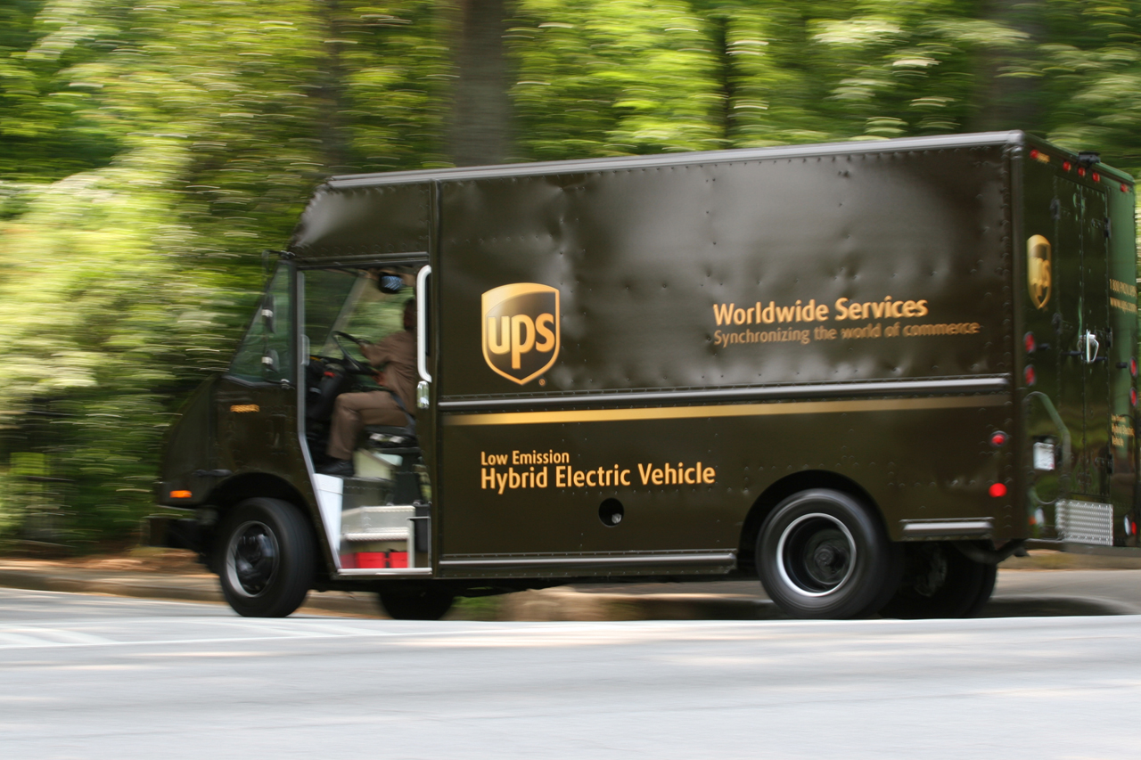

Slide 20
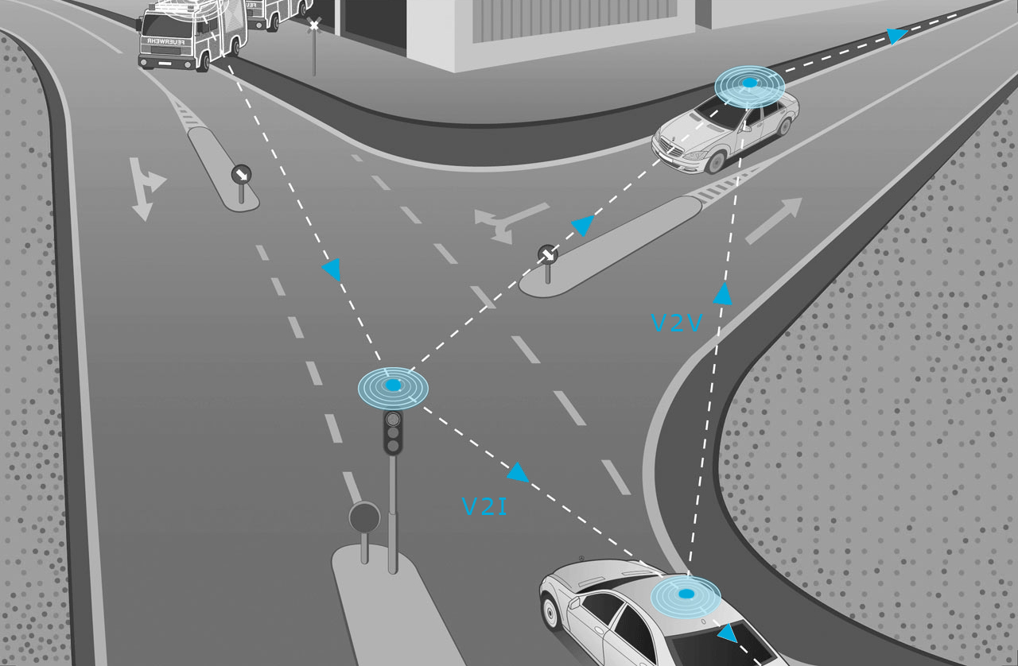
V2E, V2I, V2V

Slide 21
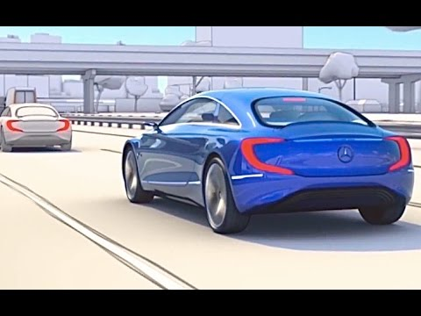

Slide 22
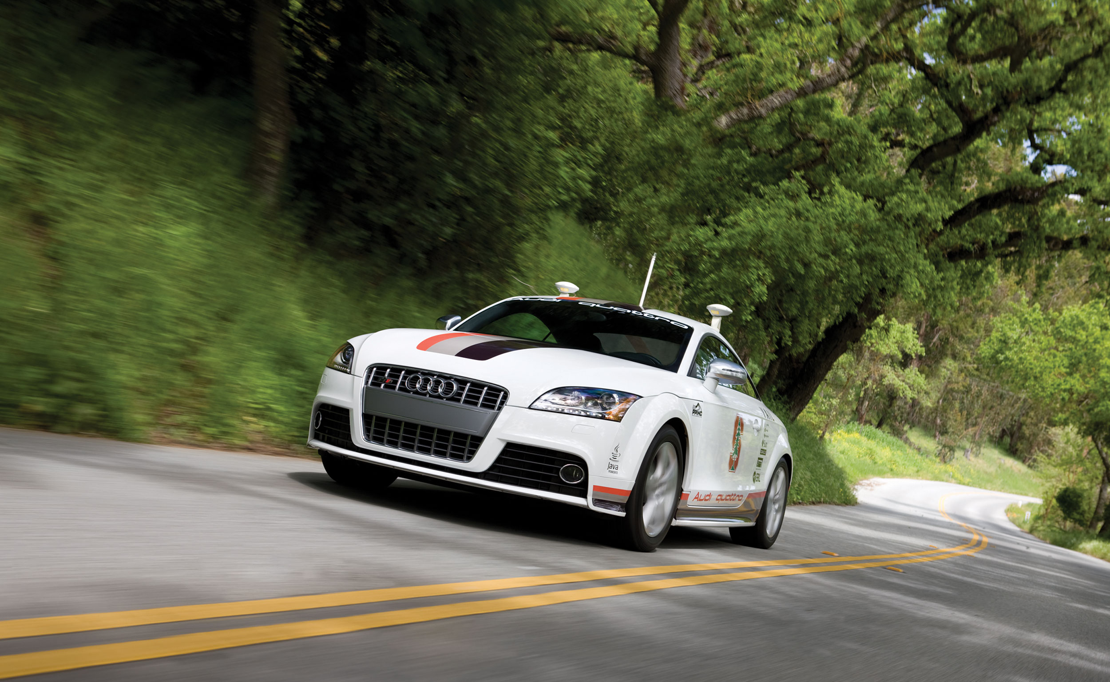
Self-driving car
Notes:
Google, Audi, Mercedes, Uber

Slide 23
Infotainment!

Slide 24
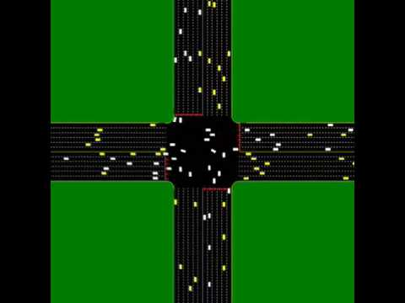

Slide 25


Slide 26
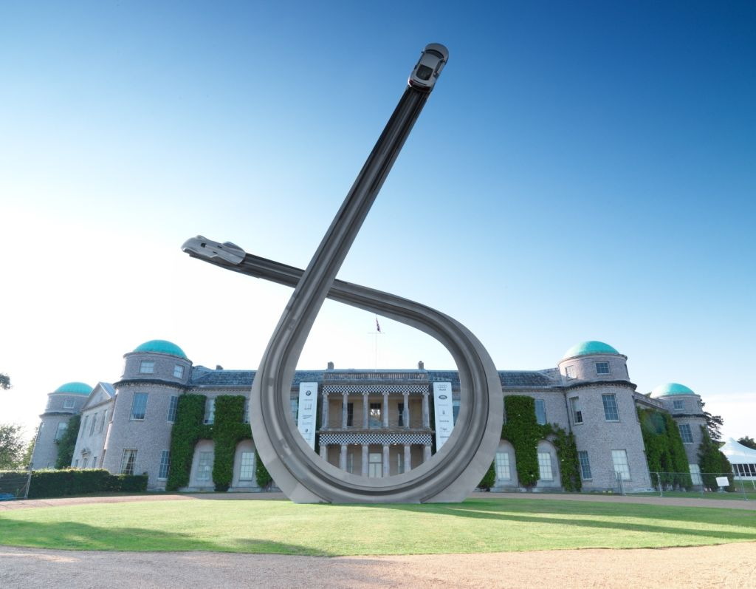
Great Things Start Here
Twitter: @victor_haydin.
Email: victor.haydin@gmail.com

Slide 27
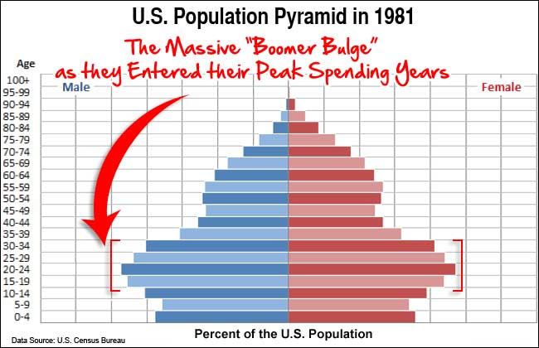

Slide 28
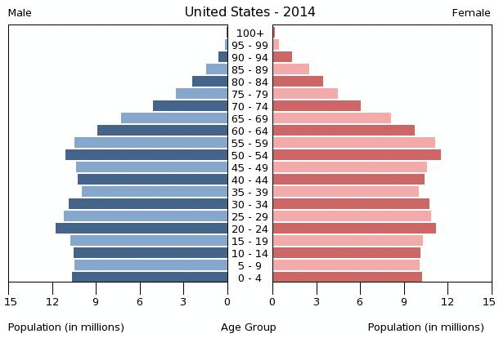

Slide 29
